Slide 1
Resting Alpha state activity related to SNR 50
Methods
Participants (n=38): Mean age=65 (31-78). Mild to moderate hearing loss. Hearing aid users
Measures:
Alpha power (7.5-12.5 hz) in occipital brain regions
Signal to noise ratio (SNR) threshold at 50% correct (SNR-50)
Subjective measures of hearing loss
EEG
64-channel EEG monitored using Neuroscan
Reference – Cz. Ground – Afz
Eyes alternate between open and closed conditions lasting 2 minutes each. 3 trials. 12 minutes total
EEG data analyzed in Matlab using Fieldtrip
Data bandpass filtered between .5 and 50 hz
Independent component analysis removed components related to signal, eye movement, and cardiac noise
FFT analysis run using Hanning window
Alpha power calculated between 7.5 and 12.5 hz
Alpha peak selected between 7.5 and 12.5 hz. Peak +/- 2hz are selected as a 4 hz window.
Alpha peak power is calculated around 4 hz window

Slide 2
SNR study
MoCA – Montreal Cognitive Assessment
Test Box Measures
ANSI
DIR (SNR = 3)
DNR (AC 70 dB)
ANL (Unaided) – Acceptable Noise Level
HINT/PPT (Unaided)- Hearing In Noise Test
Real Ear Measures
MLST & Listening Effort Estimates – Multimodal Lexical Sentence Test
APHAB – Abbreviated Profile of Hearing Aid Benefit
HHIE/HHIA – Hearing Handicap Inventory for Elderly
DOSO – Development of the Device-Oriented Subjective Outcome SADL – Satisfaction with Amplification in Daily Life IOI-HA – International Outcome Inventory for Hearing Aids
SSQ12 – Speech Spatial and Qualities of Hearing
ALDQ
LESQ
NEO-FFI
Reading Span
Word Span

Slide 3
lm(formula = alpha_peak_ERP_occ ~ alpha_power_peak_ratio + snr50_psycho +
aud + SSQ2 + aphab_unaided_bn + aphab_unaided_rv + aphab_aided_ec +
hint_srt_spshn_perceptual, data = all_data)
Residuals:
Min 1Q Median 3Q Max
-1.15954 -0.34939 0.04338 0.28094 1.96937
Coefficients:
Estimate Std. Error t value Pr(>|t|)
(Intercept) -1.917251 1.430922 -1.340 0.1923
alpha_power_peak_ratio 1.255031 0.607674 2.065 0.0494 *
snr50_psycho -0.148861 0.065957 -2.257 0.0330 *
aud 0.064608 0.023818 2.713 0.0119 *
SSQ2 0.007827 0.008026 0.975 0.3388
aphab_unaided_bn 0.015110 0.010583 1.428 0.1657
aphab_unaided_rv -0.018072 0.009758 -1.852 0.0759 .
aphab_aided_ec 0.049346 0.019811 2.491 0.0197 *
hint_srt_spshn_perceptual -0.042590 0.055438 -0.768 0.4495
---
Signif. codes: 0 ‘***’ 0.001 ‘**’ 0.01 ‘*’ 0.05 ‘.’ 0.1 ‘ ’ 1
Residual standard error: 0.7446 on 25 degrees of freedom
(1 observation deleted due to missingness)
Multiple R-squared: 0.4371, Adjusted R-squared: 0.257
F-statistic: 2.427 on 8 and 25 DF, p-value: 0.04301

Slide 4
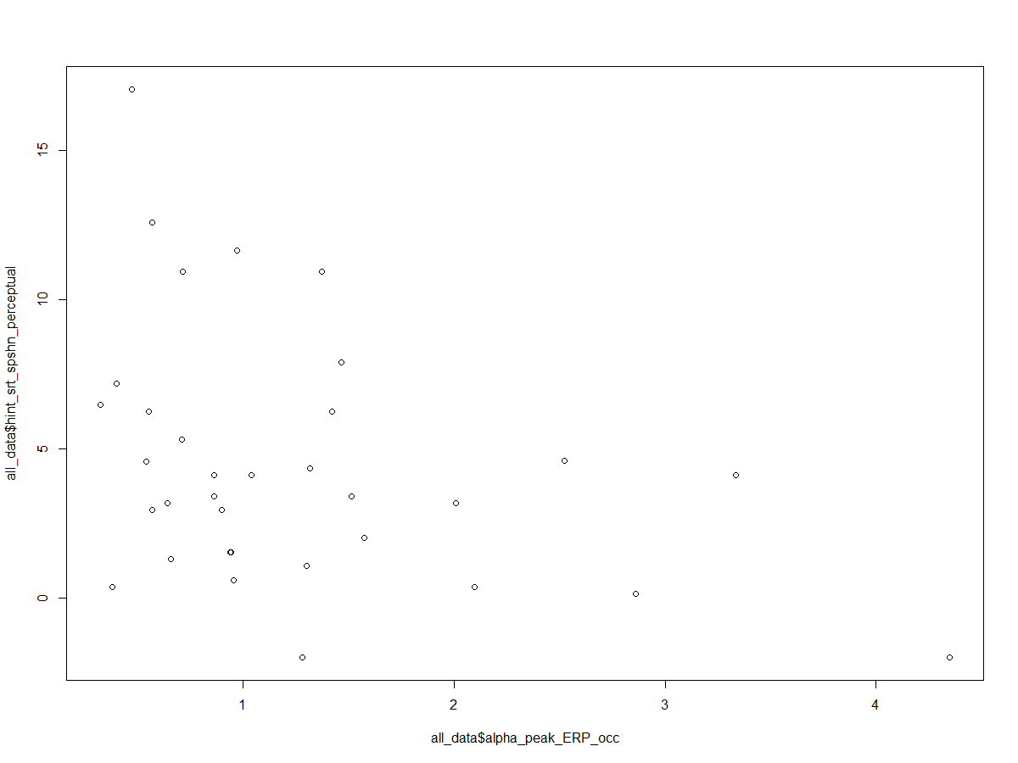
lm(formula = alpha_peak_ERP_occ ~ alpha_power_peak_ratio + snr80_psycho +
snr50_psycho + aud + SSQ2 + aphab_unaided_bn + aphab_unaided_rv +
aphab_unaided_av + aphab_aided_ec + hint_srt_spshn_perceptual,
data = all_data)
Residuals:
Min 1Q Median 3Q Max
-1.20944 -0.34740 -0.06575 0.28786 1.36825
Coefficients:
Estimate Std. Error t value Pr(>|t|)
(Intercept) -3.464235 1.589212 -2.180 0.03976 *
alpha_power_peak_ratio 1.338351 0.594833 2.250 0.03432 *
snr80_psycho 0.208540 0.102109 2.042 0.05275 .
snr50_psycho -0.323996 0.136755 -2.369 0.02660 *
aud 0.076671 0.023661 3.240 0.00361 **
SSQ2 0.011311 0.007670 1.475 0.15388
aphab_unaided_bn 0.018120 0.009621 1.883 0.07235 .
aphab_unaided_rv -0.013998 0.008964 -1.561 0.13207
aphab_unaided_av -0.009628 0.006572 -1.465 0.15646
aphab_aided_ec 0.061794 0.018469 3.346 0.00280 **
hint_srt_spshn_perceptual -0.169444 0.055347 -3.061 0.00553 **
---
Signif. codes: 0 ‘***’ 0.001 ‘**’ 0.01 ‘*’ 0.05 ‘.’ 0.1 ‘ ’ 1
Residual standard error: 0.6725 on 23 degrees of freedom
(1 observation deleted due to missingness)
Multiple R-squared: 0.6105, Adjusted R-squared: 0.4411
F-statistic: 3.605 on 10 and 23 DF, p-value: 0.005301
(alpha_ERP[,c(7,8,9,10,15,16,17,25,26,31,32,33,34,48,49,50,51,53)

Slide 5
lm(formula = alpha_peak_ERP_occ ~ alpha_power_peak_ratio + snr80_psycho +
snr50_psycho + aud + SSQ2 + aphab_unaided_bn + aphab_unaided_rv +
aphab_unaided_av + aphab_aided_ec + hint_srt_spshn_perceptual,
data = all_data)
Residuals:
Min 1Q Median 3Q Max
-1.2080 -0.3155 -0.0673 0.2061 1.4345
Coefficients:
Estimate Std. Error t value Pr(>|t|)
(Intercept) -3.576464 1.641141 -2.179 0.04030 *
alpha_power_peak_ratio 1.259296 0.641295 1.964 0.06233 .
snr80_psycho 0.205219 0.104788 1.958 0.06298 .
snr50_psycho -0.322999 0.141123 -2.289 0.03206 *
aud 0.079602 0.024980 3.187 0.00426 **
SSQ2 0.012003 0.007951 1.510 0.14534
aphab_unaided_bn 0.018713 0.009903 1.890 0.07205 .
aphab_unaided_rv -0.013365 0.009240 -1.446 0.16214
aphab_unaided_av -0.010600 0.006866 -1.544 0.13687
aphab_aided_ec 0.061885 0.018950 3.266 0.00354 **
hint_srt_spshn_perceptual -0.176744 0.056983 -3.102 0.00520 **
---
Signif. codes: 0 ‘***’ 0.001 ‘**’ 0.01 ‘*’ 0.05 ‘.’ 0.1 ‘ ’ 1
Residual standard error: 0.6901 on 22 degrees of freedom
(1 observation deleted due to missingness)
Multiple R-squared: 0.6118, Adjusted R-squared: 0.4353
F-statistic: 3.466 on 10 and 22 DF, p-value: 0.007194

Slide 6
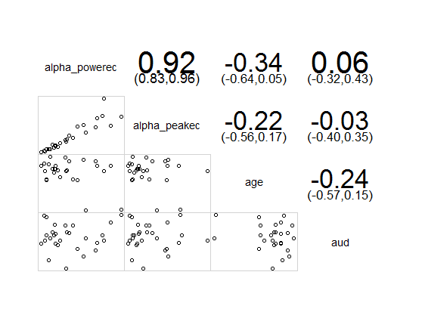
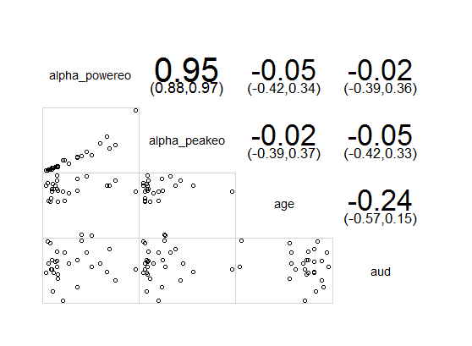
Alphapower vs age and audibility
Eyes Closed
Eyes Open

Slide 7
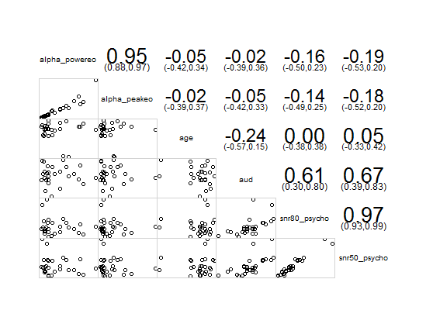

Alpha power vs SNR 50 and SNR 80

Slide 8
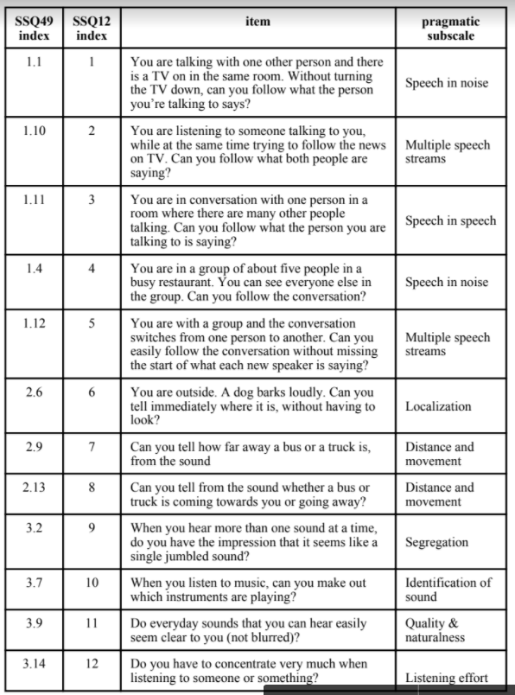
SSQ categorized
lm(formula = alpha_power_peak_ratio ~ SSQ2, data = all_data)
Residuals:
Min 1Q Median 3Q Max
-0.39029 -0.13188 0.01583 0.12879 0.49161
Coefficients:
Estimate Std. Error t value Pr(>|t|)
(Intercept) 0.761527 0.108139 7.042 3.95e-08 ***
SSQ2 -0.003667 0.001652 -2.220 0.0332 * ---
Signif. codes: 0 ‘***’ 0.001 ‘**’ 0.01 ‘*’ 0.05 ‘.’ 0.1 ‘ ’ 1 Residual standard error: 0.2153 on 34 degrees of freedom Multiple R-squared: 0.1266, Adjusted R-squared: 0.1009 F-statistic: 4.93 on 1 and 34 DF, p-value: 0.03316
Notes:
resting state may relate to temporal processing, and relate to sound localization. ERP design for temporal processing.

Slide 9
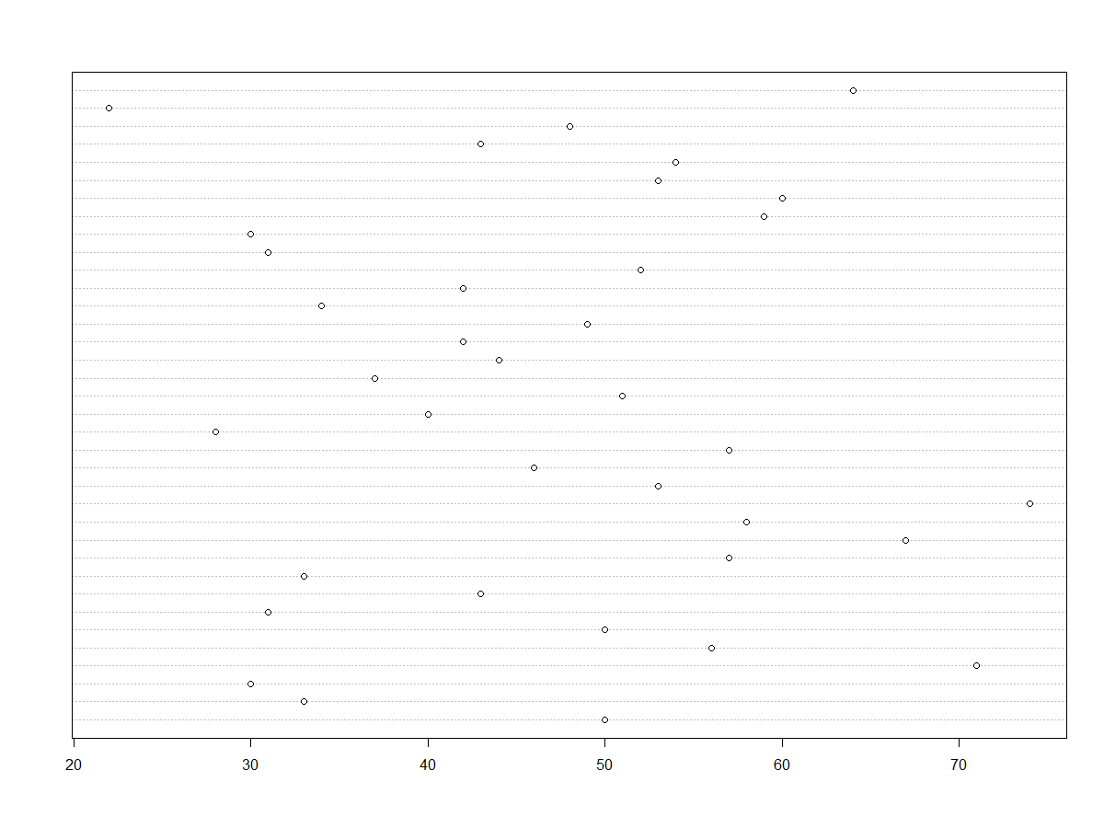
ALDQ Demand
lm(formula = aldq_demand ~ alpha_power_peak_ratio + alpha_power_peakec + alpha_power_peakeo + snr80_psycho + snr50_psycho + SSQ1 + SSQ2 + SSQ3 + aphab_unaided_ec + aphab_unaided_bn + aphab_unaided_rv + aphab_unaided_av + aphab_aided_ec + aphab_aided_bn + aphab_aided_rv + aphab_aided_av, data = all_data)
Residuals:
Coefficients:
Estimate Std. Error t value Pr(>|t|) (Intercept) 56.417056 33.800550 1.669 0.113 alpha_power_peak_ratio -5.055842 30.783531 -0.164 0.871 alpha_power_peakec 0.647862 1.340339 0.483 0.635 alpha_power_peakeo -1.297697 2.879125 -0.451 0.658 snr80_psycho 1.161353 2.022619 0.574 0.573 snr50_psycho -3.306467 3.013500 -1.097 0.288
SSQ1 -0.176235 0.214662 -0.821 0.423
SSQ2 -0.004642 0.190793 -0.024 0.981
SSQ3 0.184676 0.274937 0.672 0.511 aphab_unaided_ec 0.163848 0.254763 0.643 0.529 aphab_unaided_bn -0.301510 0.315075 -0.957 0.352 aphab_unaided_rv 0.157114 0.214812 0.731 0.474 aphab_unaided_av -0.148152 0.231992 -0.639 0.532 aphab_aided_ec 0.233544 0.684207 0.341 0.737 aphab_aided_bn 0.032432 0.267178 0.121 0.905 aphab_aided_rv -0.165626 0.267673 -0.619 0.544 aphab_aided_av 0.065408 0.181108 0.361 0.722
Residual standard error: 14.83 on 17 degrees of freedom (2 observations deleted due to missingness) Multiple R-squared: 0.318, Adjusted R-squared: -0.324 F-statistic: 0.4953 on 16 and 17 DF, p-value: 0.9164

Slide 10
Next steps
Classify successful and unsuccessful users by ALDQ demand
cluster, K-means
Logistic modeling of alpha, SNR, and subjective measures
Complete ICA of alpha power during sound stimulus (ERP)
Model alpha power during ERP with other predictor variables

